Slide 1
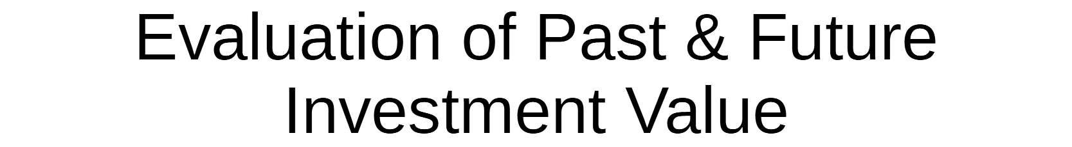


Slide 2
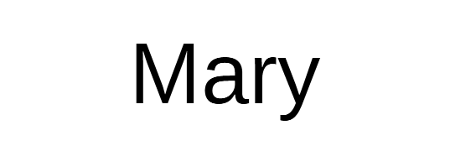
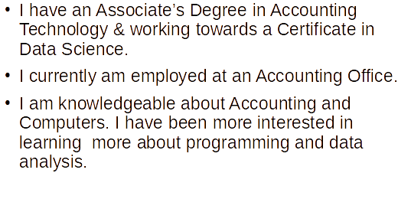
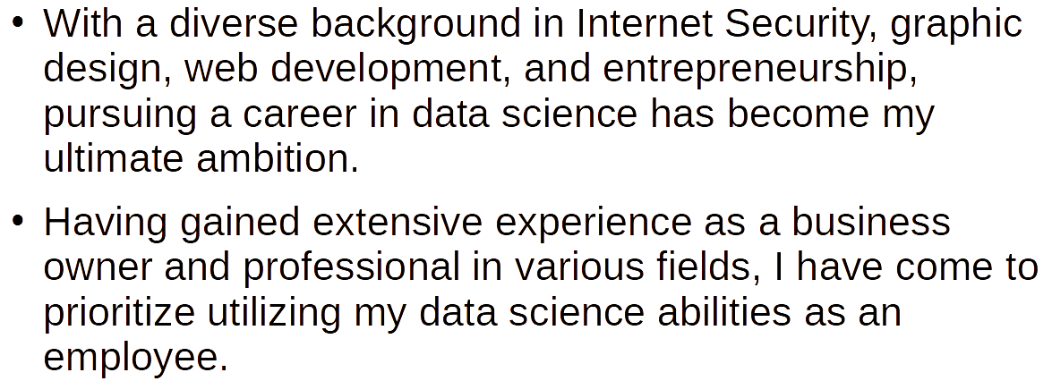
Krista
Kori
Christophe
I am employed as an Inventory Specialist and pursuing a career outside of retail
I’ve always had an interest in learning to program and data analysis but afraid to take that first step until now
In regards to my knowledge and understanding of data analysis and programming I am a beginner
I am currently employed as a Correspondence Administrator
I am currently learning Data science to enhance and make a career change
I am a little knowledgeable of stock price trends and currently pursuing more knowledge.

Slide 3
Background/History

Slide 4
Background/History

Slide 5
Methods Used

Slide 6
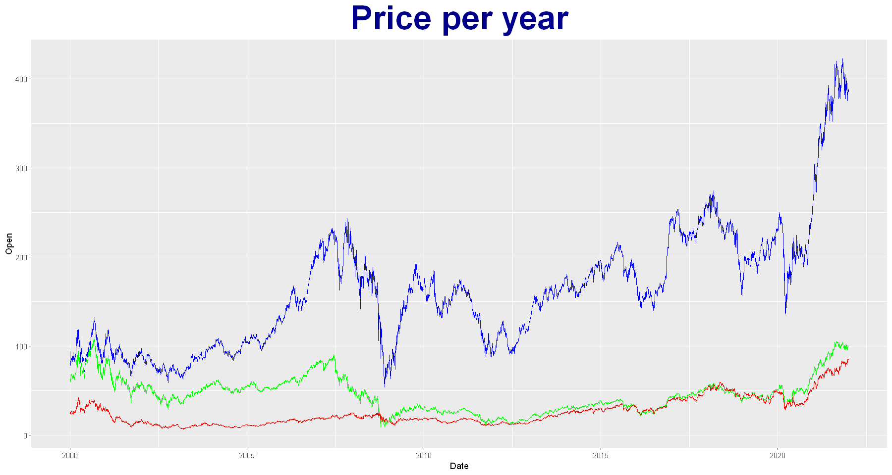
Goldman Sachs (blue)
Morgan Stanley (green)
Schwab (red)
Notes:
Mary: When speaking about stock volatility, you are looking at the rate in which a stock increases or decreases over a particular period. Goldman Sachs is the most volatile since the stock prices are a lot higher and have more risk than the stocks for Morgan Stanley and Schwab. Looking at the graph, you can see that Schwab would be the best stock option to buy when it comes to the volatility between the stock.

Slide 7
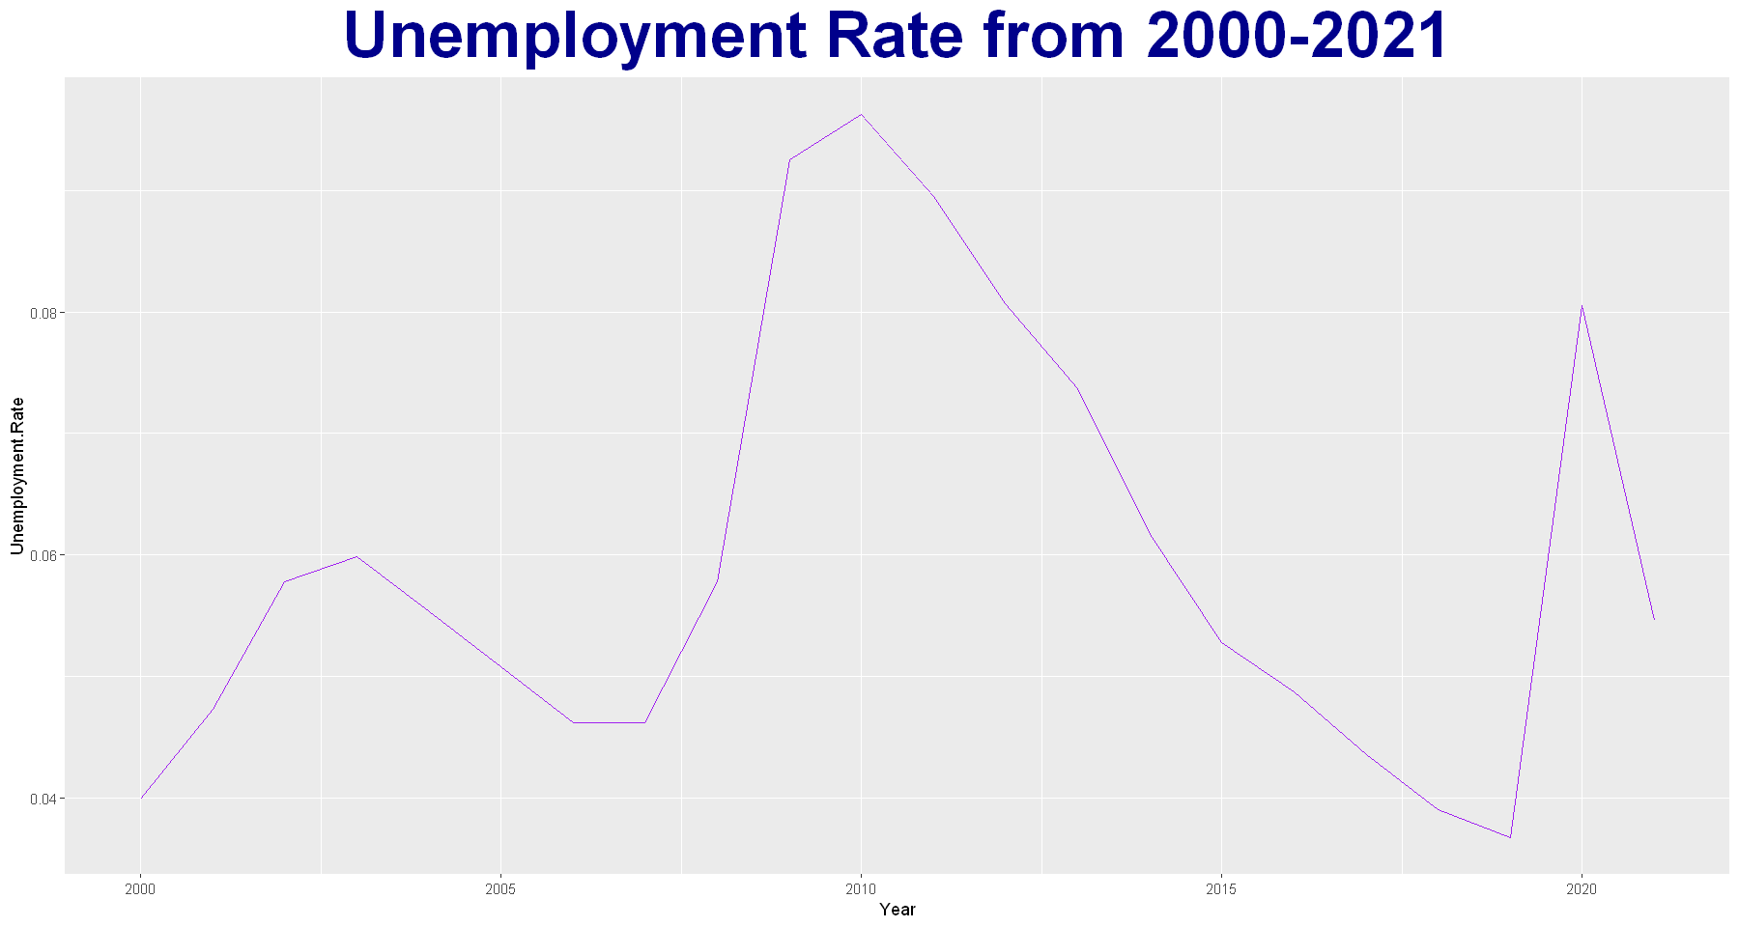
Notes:
Mary: The Unemployment Rate also played a factor in the rise & fall of the stocks. As the unemployment rate went up, the stock prices also increased. The Feds would lower interest rates which would in turn cause investors to buy more stocks.
Highest Unemployment Rate is in 2010, which is during the slow economic growth after the Great Recession.

Slide 8
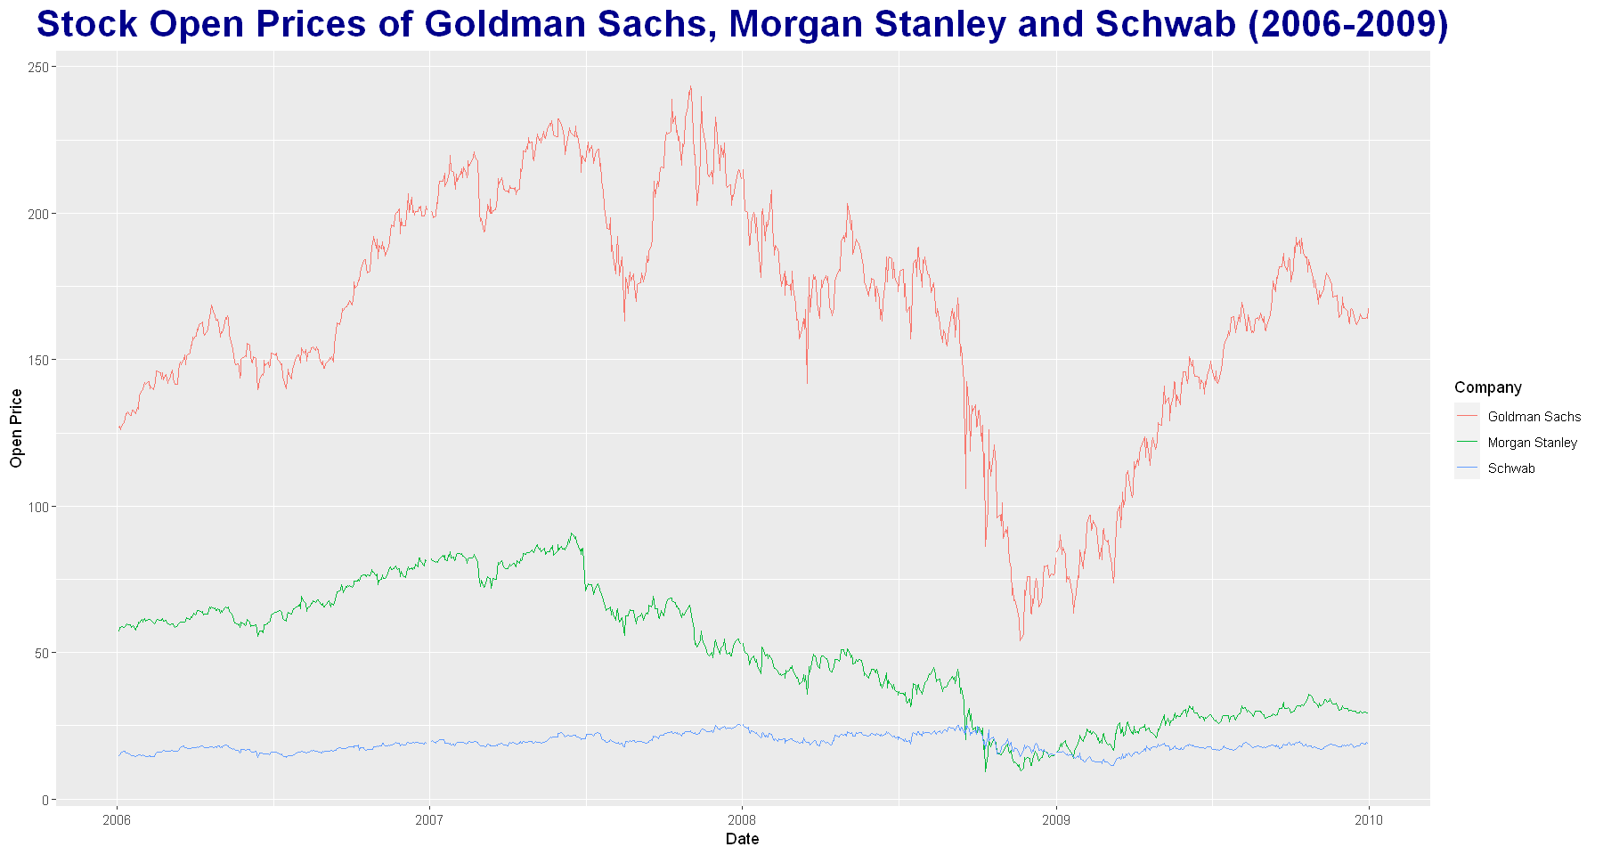
Notes:
Mary: When the Housing Market Crashed in 2006, more demand for stocks led to increased prices in stocks. As the Great Recession hit, the demand for stocks decreased therefore, the price decreased based off the demand of the stocks.
The predatory home loan private lending driven by the insatiable investor demand for mortgage-related investments that led up to the crash in 2008.
At the beginning of the Great Recession (December 2007), stock prices were up due to more demand of stocks. The stocks fluctuate throughout the first part of 2008 as the recession went on, stocks were not bought as much. September of 2008, Goldman Sachs stocks started going down at a faster pace than Morgan Stanley and Schwab due to stocks being sold due to less demand. Near the end of the Recession in 2008, the demand for stocks started going up again. The Stock prices continued to rise through most of 2009, even after the Housing Market Crash ended July 2009.

Slide 9
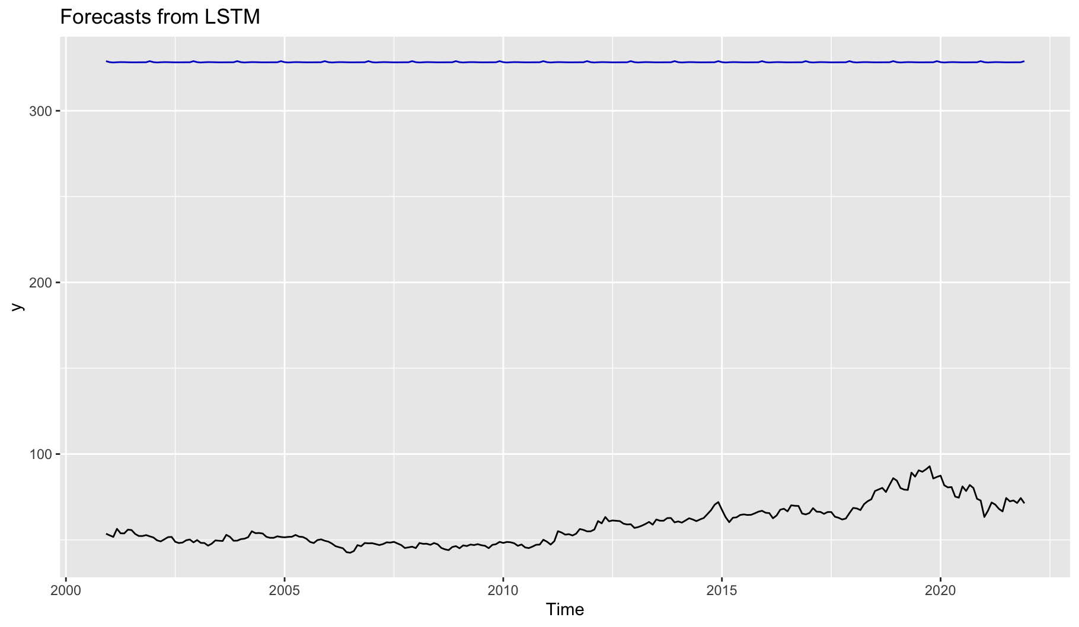
Forecast prediction for Goldman Sachs
From 2000 until 2010
It seems the stocks
Notes:
Kori

Slide 10
Results - Kori

Slide 11
Results - Krista

Slide 12
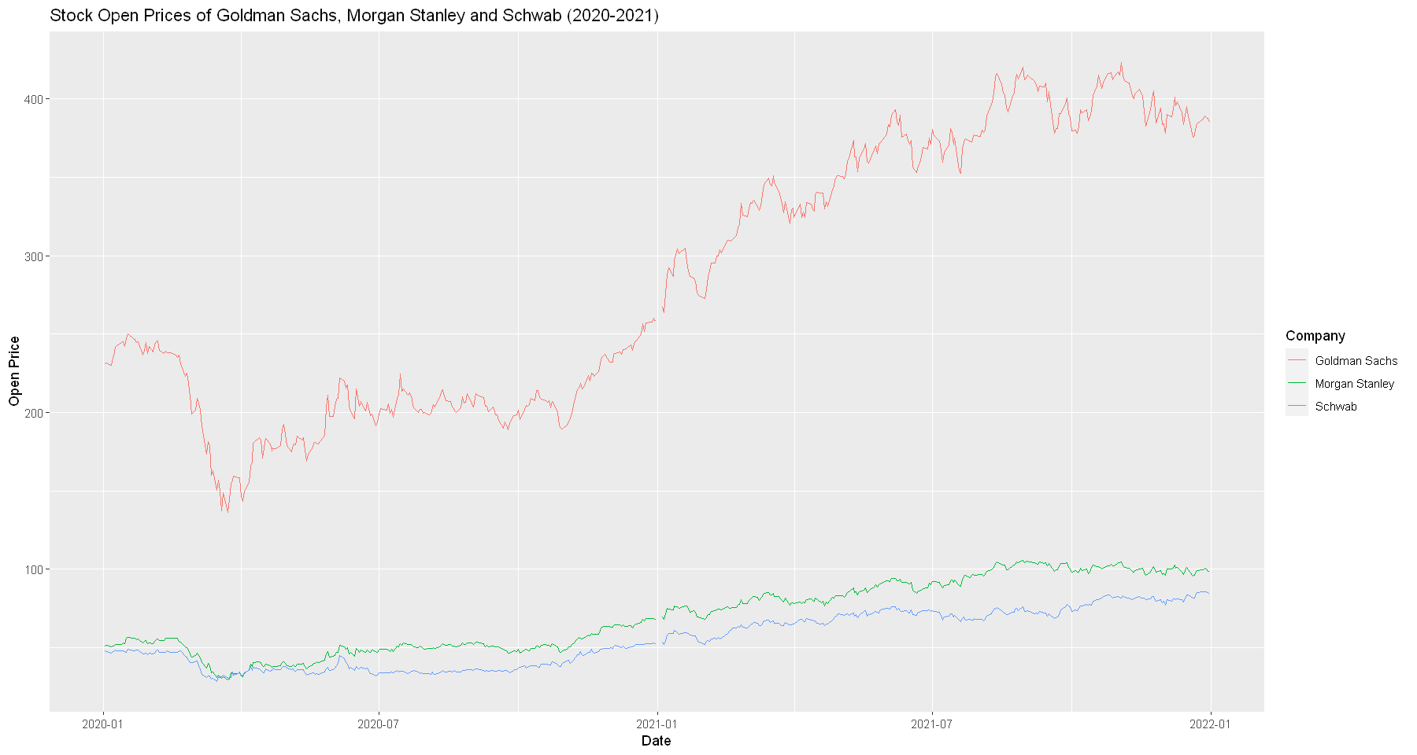
Results - Christophe
February 2020 decline due to stock market crash from Covid
Summer beginning increase due to Feds lowering interest rates causing investors to invest instead of sell.
Notes:
Christophe: In the beginning of 2020 all 3 stocks saw a sharp decline around February. Due to the increase in cases of Covid the World Health Organization declared a global pandemic which saw business closing and a rise in unemployment rate. In turn the Federal Government lowered interest rates which saw investors doing the opposite of what they usually do during a crash which was invest rather than sell. This growth is shown during the summer of 2020 as all three stocks begin to show a small increase. Over time as the Federal Government passed multiples bills to help stimulate the economy investors saw this as a push to further continue investing in and holding their stocks rather than selling said stocks.

Slide 13
Summary
When it comes to the volatility of a stock, it would be wiser to choose a less volatile stock which will reduce the risk.
From 2006-2010, the Housing Market, the Great Recession, and the Unemployment Rate affected the stock market. The Unemployment Rate reached its highest point in 2010 when the economic growth was slowly returning after the Great Recession.
The Unemployment Rate would play a factor in the rise & fall of stocks causing the Feds to lower interest rates resulting in investors buying more stocks
In February 2020, the Covid pandemic caused the stock market to crash. Summer of 2020 is when the stock market growth started again, after the Unemployment Rate reached a high.
Notes:
Mary

Slide 14
Conclusion
By looking at several of the graphs, we are able to tell which one is more volatile as well as getting a better understanding as to whether we should buy, sell, or hold stocks.
We are able to understand and track trends, best times to buy/sell, and be able to forecast future prices. By looking at the graphs and learning about the history, we are able to see which variables, unemployment, Covid, Great Recession, etc., affect the stock prices. In some cases, we can see where multiple variable play a part in a given time period and can use it to predict future prices.
Stock prices are affected by multiple variables at any given time. It could have a small term effect or a long term effect on the stock market. By looking into the differences between multiple stocks, we were able to determine the minor/major differences between the higher risk stocks versus the lower risk stocks.
Notes:
Mary

Slide 15
Questions?

